Slide 1

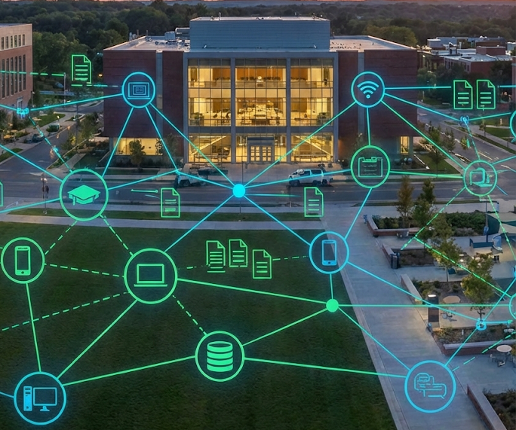
Design and Configuration of a University Campus Network
A Hierarchical Approach to Scalable & Secure Infrastructure
Sazzad Hossain Naim
664056
Diploma in Computer Science and Technology

Slide 2

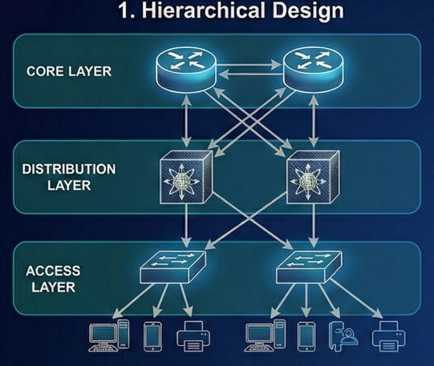
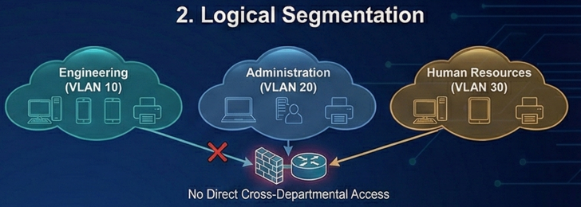
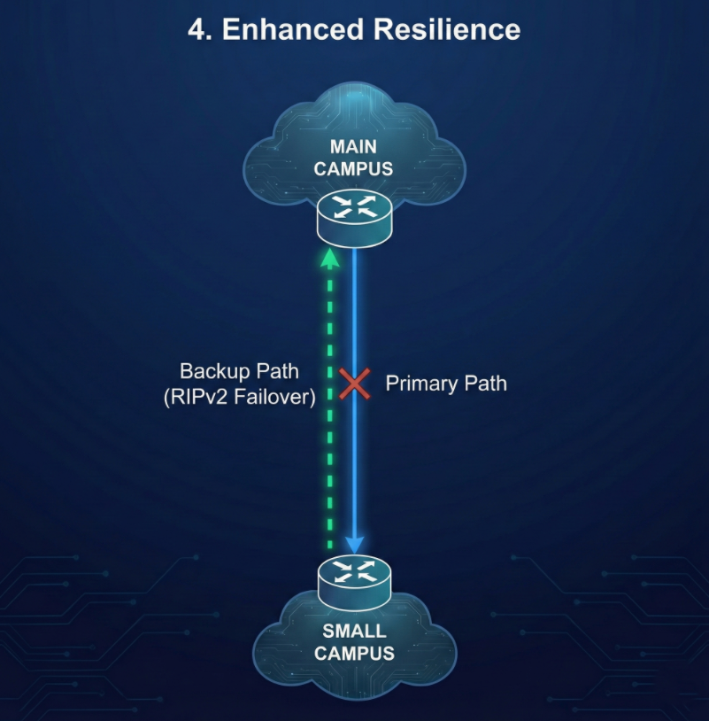
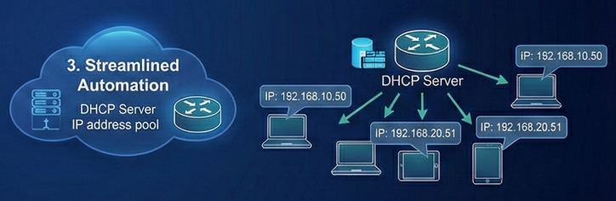
Project Objectives: Building a Smarter Campus
1
2
Hierarchical Design
Restructure the network into distinct Core, Distribution, and Access layers for enhanced modularity and fault isolation.
Logical Segmentation
Implement VLANs to logically isolate departments like Engineering, Administration, and Human Resources, preventing unauthorized cross-departmental access.
3
4
4
Streamlined Automation
Deploy DHCP on network routers to automatically assign IP addresses to end devices, minimizing manual configuration and IT overhead.
Enhanced Resilience
Utilize RIPv2 dynamic routing to ensure continuous connectivity between Main and Small campuses, even with network topology changes or failures.

Slide 3
The Problem: Why Upgrade?
The "Flat Network" Chaos
Legacy Issue
Many campuses traditionally operate with "flat" networks where all devices reside in a single, undifferentiated broadcast domain. This creates an environment akin to a single, chaotic room where everyone can hear everything.
Broadcast Storms
Excessive broadcast traffic, such as ARP requests, inundates all network devices. This leads to severe congestion and dramatically slows down data transmission and overall network performance, impacting user experience.
Security Risks
Without logical segmentation, there are no effective barriers. Students could theoretically access sensitive Finance servers, posing a significant threat to data confidentiality and integrity.
Manual Management
IT staff are burdened with the laborious and error-prone task of manually configuring IP addresses for hundreds of individual PCs. This process is inefficient, scales poorly, and is prone to human error.

Slide 4

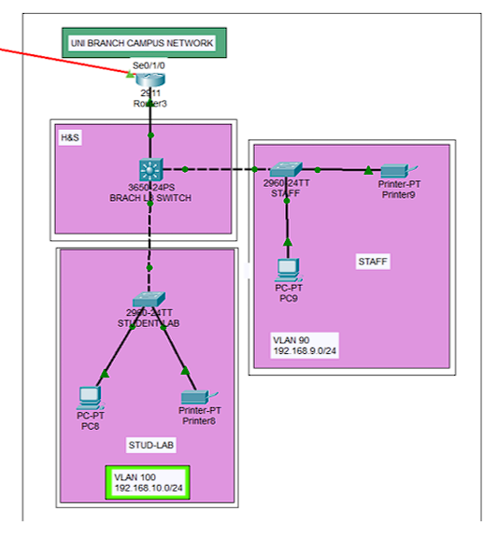
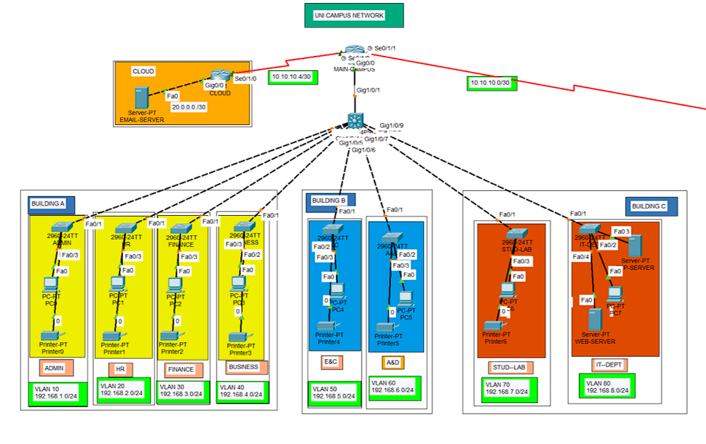
The Architecture: Connecting the Campuses
Small Campus & Inter-Campus Link
A dedicated Small Campus serves Health & Sciences, requiring stable and secure connectivity for specialized applications and research.
This campus is seamlessly integrated via a high-speed Wide Area Network (WAN) link to the Main Campus, ensuring uninterrupted communication and resource sharing.
Main Campus Overview
Building A (Admin): Houses sensitive administrative functions with strict security policies, utilizing VLANs 11-13 to safeguard critical data.
This robust architecture supports the diverse needs of both campuses while maintaining centralized control and security.
Building B (Academic): Supports high traffic for Engineering & Arts departments, requiring robust performance and bandwidth, configured with VLANs 15 and 17.
Building C (IT Core): Functions as the central hub for the Web Server and IT staff, critical for overall campus operations and network management.

Slide 5
Key Technologies: The Network Stack
VLANs (Virtual Local Area Networks)
Concept: Logically dividing a single physical switch into multiple isolated virtual broadcast domains.
Application: Ensures that Engineering students (VLAN 15) cannot access confidential HR data (VLAN 12), even when sharing the same physical network hardware, enhancing security and reducing broadcast traffic.
RIPv2 (Routing Information Protocol v2)
Concept: A distance-vector routing protocol allowing routers to dynamically discover and update routes to other networks.
Why RIPv2? Chosen for its simplicity, ease of configuration, and full support for Variable Length Subnet Masks (VLSM), making it ideal for our campus network's scale (<15 router hops).
DHCP (Dynamic Host Configuration Protocol)
Concept: A network protocol that enables a server to automatically assign an IP address and other communication parameters to devices connected to the network.
Result: Eliminates the need for manual IP configuration on end-user devices, significantly reducing IT workload and user setup friction, leading to a more efficient and user-friendly experience.

Slide 6



Testing & Verification: Did It Work?
Rigorous testing confirmed the successful implementation and functionality of the hierarchical network design.
Connectivity Test
Scenario: An administrative PC attempts to ping a server in the Finance department.
Result: Success! (Latency consistently < 2ms), demonstrating efficient inter-VLAN routing and reliable communication paths critical for business operations.
Security Test
Scenario: A student PC in a lab attempts to ping a host within the restricted Admin Network.
Result: Denied! Traffic was effectively blocked by the implemented Access Control Lists and VLAN isolation logic, validating robust security policy enforcement.
Automation Test
Scenario: A new PC is plugged into a network port in Building A.
Result: Automatic IP! The PC successfully received an IP address (e.g., 192.168.1.x) from the configured DHCP server, confirming seamless plug-and-play functionality and reduced IT intervention.

Slide 7
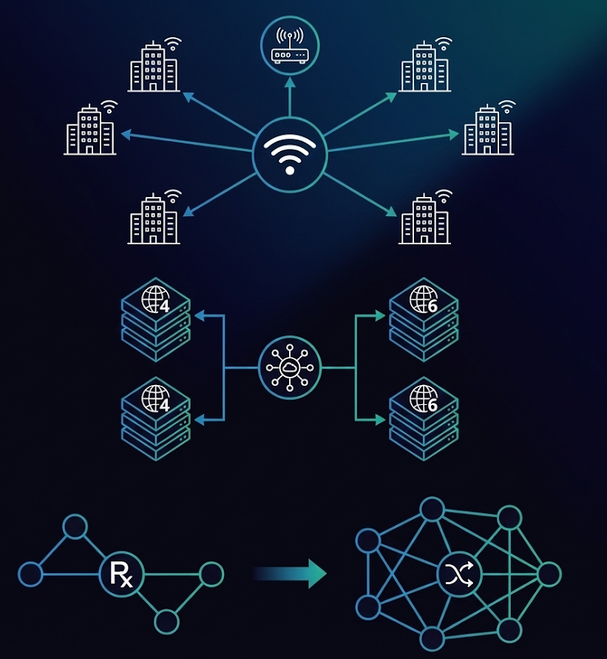



Future Improvements: Scaling Up
Wireless Integration
Integrate a centralized Wireless LAN Controller (WLC) to provide seamless, secure, and scalable campus-wide Wi-Fi connectivity (e.g., supporting Eduroam). This is crucial for modern digital learning environments and ubiquitous access.
IPv6 Adoption
Implement a dual-stack IPv4/IPv6 environment to future-proof the network against IPv4 address exhaustion. This will support emerging technologies and significantly enhance network capacity and efficiency for years to come.
Migrate to OSPF
As the campus network grows beyond RIPv2's 15-hop limit and administrative domains expand, migrating to OSPF (Open Shortest Path First) will provide faster convergence, better scalability, and more efficient routing for an enterprise-grade infrastructure.

Slide 8
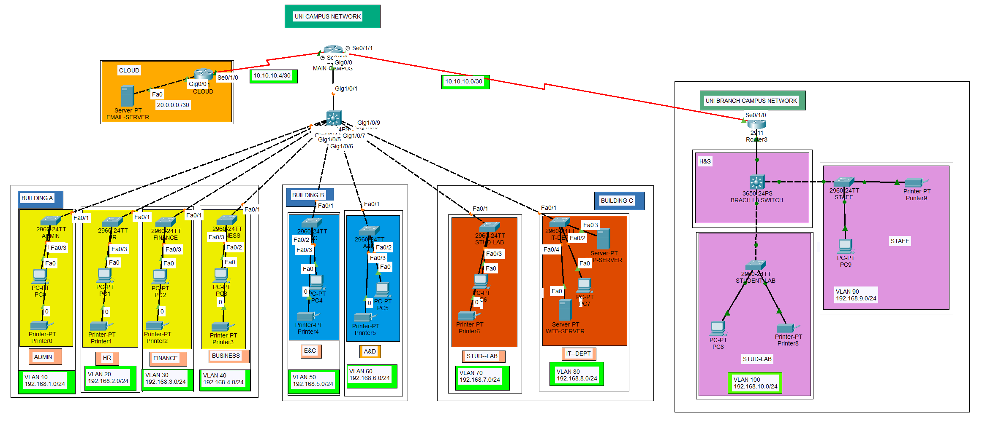
The Final Model: A Breakdown

Slide 9


Thank You!
Feedbacks?

